Slide 1



s
Alpha Tech Academy
Katalog Binatang

Slide 2

TEAM LIST
Pajar W. P.
Olivia D. A. S

Slide 3

PROJECT PREPARATION - Analisa Project
Menyiapkan GitHub
Menyiapkan Model
Menyiapkan Desain Template

Slide 4
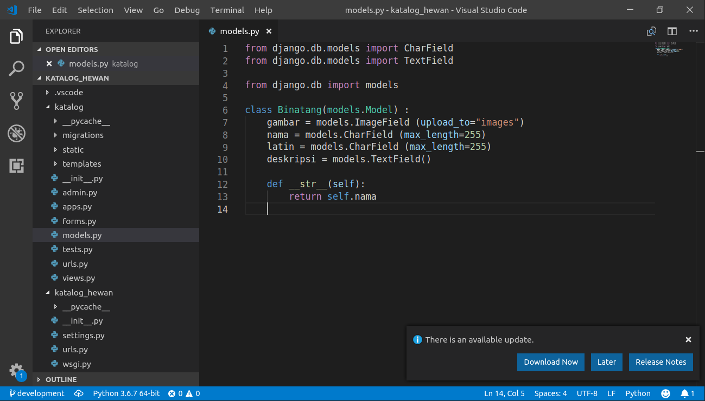
PROJECT PREPARATION - Database Model

Slide 5
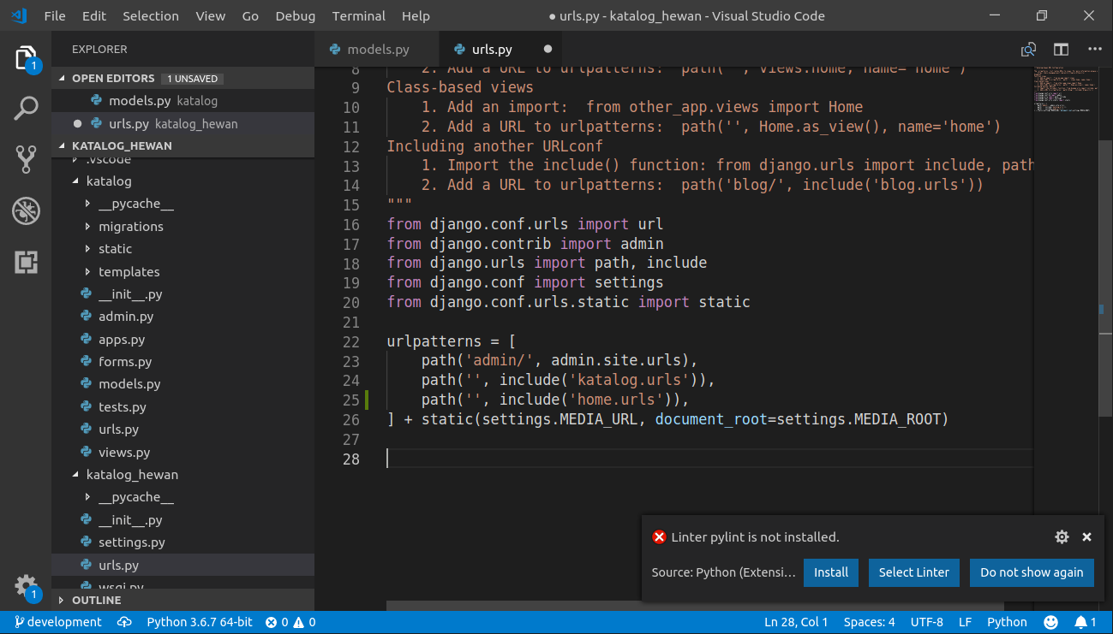
PROJECT PREPARATION - Views & URL

Slide 6
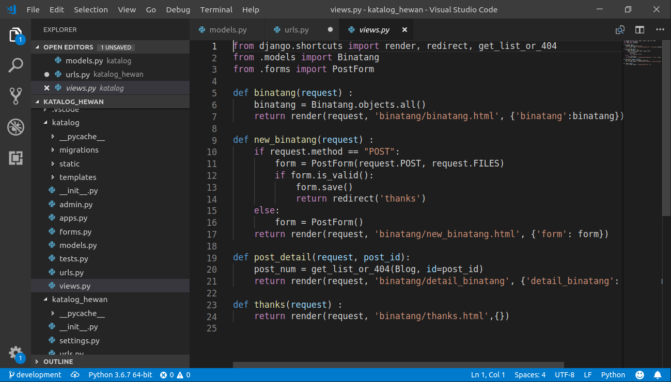
PROJECT PREPARATION - Views & URL

Slide 7
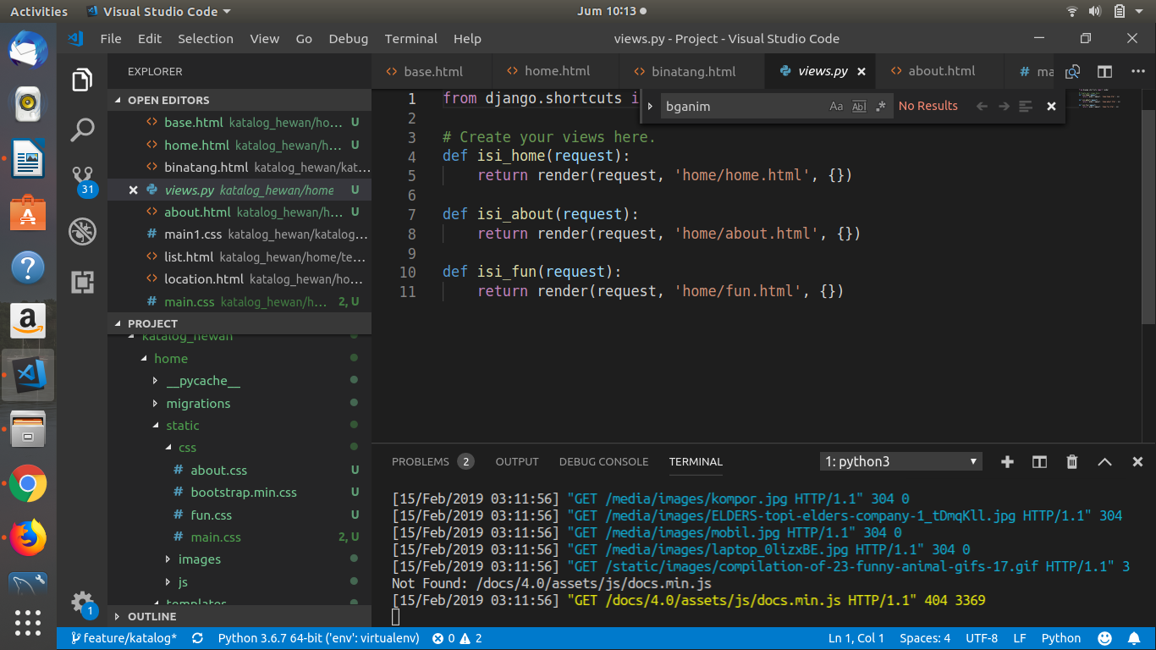
PROJECT PREPARATION - Views & URL

Slide 8


PROJECT PREPARATION - Extra Preparation
Kendala :
Git
Template setelah di merge
Cerita Sukses :
Tampilan kembali

Slide 9
PROJECT DEMO

